Slide 1
House Sales price prediction

Slide 2
ABSTRACT
Predictive models for determining the sale price of houses in cities is still remaining as more challenging and tricky task. The sale price of properties in cities like Bengaluru depends on a number of interdependent factors.
The purpose is to create a model that can estimate housing prices. The input dataset was taken from the dataset repository. Then, we have to implement the pre-processing techniques.
We have to implement the regression technique to predict the housing price such as Ridge and lasso regression. Finally, the experimental results shows that the error values, estimate the house price in Lakhs.

Slide 3
OBJECTIVES
The main objective of our project is,
To predict the house price based on different locations.
To implement the machine learning algorithm.
To enhance the overall performance for classification algorithms.

Slide 4
EXISTING SYSTEM
In existing, Predictive models for determining the sale price of houses in cities like Bengaluru is still remaining as more challenging and tricky task. The sale price of properties in cities like Bengaluru depends on a number of interdependent factors.
Key factors that might affect the price include area of the property, location of the property and its amenities. In this research work, an analytical study has been carried out by considering the data set that remains open to the public by illustrating the available housing properties in machine hackathon platform.
The data set has nine features. In this study, an attempt has been made to construct a predictive model for evaluating the price based on the factors that affect the price.
Modelling explorations apply some regression techniques such as multiple linear regression (Least Squares), Lasso and Ridge regression models, support vector regression, and boosting algorithms such as Extreme Gradient Boost Regression (XG Boost).

Slide 5
DISADVANTAGES
The results is low when compared with proposed
It doesn’t efficient for large volume of data’s
Theoretical limits.

Slide 6
PROPOSED SYSTEM
In this system, the house dataset was taken as input from the dataset repository. Then, we have to implement the data pre-processing step. In this step, we have to handle the missing values for avoid wrong prediction. Then, we have to split the data into test and train.
In this step, test is used for predict the model and train is used for evaluate the model.
We have to implement the machine learning regression algorithms such as Ridge and lasso regression .
Finally, the experimental results shows that the performance metrics such as MAE and predict the house price based on input attributes.

Slide 7
ADVANTAGES
It is efficient for large number of datasets.
The process is implemented with removing the unwanted data.
The prediction is efficient.

Slide 8
FLOW DIAGRAM
Data set ( House dataset)
Input data
Handle missing value
Preprocessing
Label Encoding
Test
Drop unwanted columns
Data Splitting
Train
Classification
Lasso
Ridge Regressor
MAE
Performance Analysis
Predict the house price

Slide 9
MODULES
Data selection
Data preprocessing
Data splitting
Classification
Result Generation

Slide 10
Modules description

Slide 11
DATA SELECTION
• The input data was collected from dataset repository like UCI repository.
• In our process, house dataset is used.
• The data selection is the process of predicting the house price.
• The dataset contains the information about the house like square root, bed room, bath square feet and so on.,

Slide 12
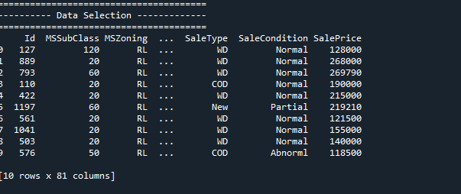
DATA SELECTION

Slide 13
DATA PREPROCESSING
Data pre-processing is the process of removing the unwanted data from the dataset.
Pre-processing data transformation operations are used to transform the dataset into a structure suitable for machine learning.
Missing data removal: In this process, the null values such as missing values and Nan values are replaced by 0.
Encoding Categorical data: That categorical data is defined as variables with a finite set of label values.

Slide 14
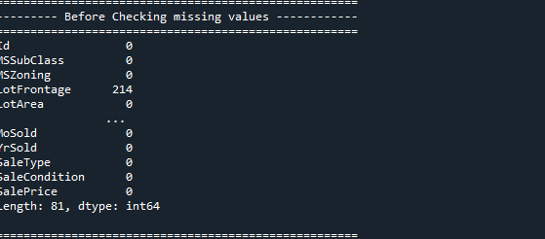
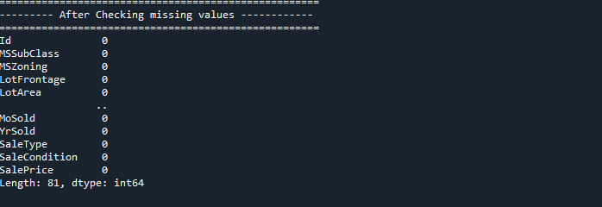
DATA PREPROCESSING

Slide 15
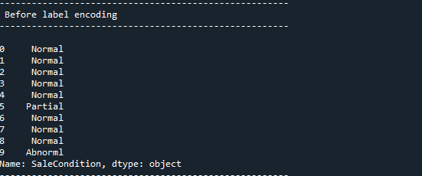
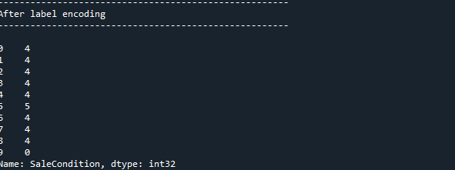
DATA PREPROCESSING

Slide 16
DATA SPLITTING
During the machine learning process, data are needed so that learning can take place.
In addition to the data required for training, test data are needed to evaluate the performance of the algorithm in order to see how well it works.
In our process, we considered 70% of the our dataset to be the training data and the remaining 30% to be the testing data.
Data splitting is the act of partitioning available data into two portions, usually for cross-validator purposes.
One Portion of the data is used to develop a predictive model and the other to evaluate the model's performance.

Slide 17
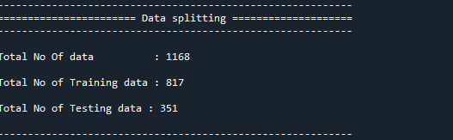
DATA SPLITTING

Slide 18
CLASSIFICATION
In our process, we have to implement the machine learning algorithms such as lasso regression and ridge regression.
Ridge regression is a model tuning method that is used to analyse any data that suffers from multicollinearity. This method performs L2 regularization. When the issue of multicollinearity occurs, least-squares are unbiased, and variances are large, this results in predicted values being far away from the actual values.
Lasso regression is a regularization technique. It is used over regression methods for a more accurate prediction. This model uses shrinkage. Shrinkage is where data values are shrunk towards a central point as the mean. The lasso procedure encourages simple, sparse models (i.e. models with fewer parameters)

Slide 19
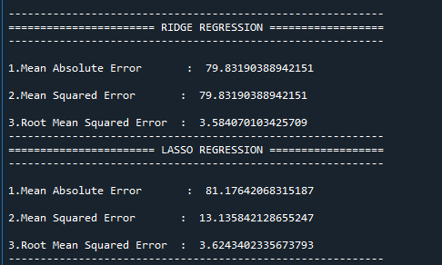
CLASSIFICATION

Slide 20
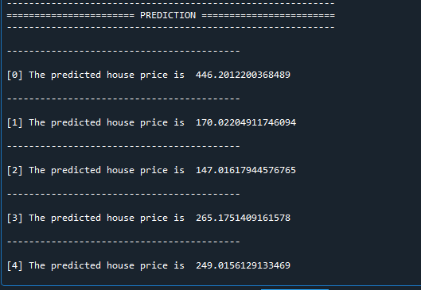
PREDICTION

Slide 21
PERFORMANCE
The Final Result will get generated based on the overall classification and prediction. The performance of this proposed approach is evaluated using some measures like,
MAE: In statistics, the mean absolute error (MAE) is a way to measure the accuracy of a given model. It is calculated as,
• Σ: A Greek symbol that means “sum”
• yi: The observed value for the ith observation
• xi: The predicted value for the ith observation
• n: The total number of observations
MAE = (1/n) * Σ|y_{i} – x_{i}|

Slide 22
LITERATURE SURVEY
Title | Year | Author | Methology | Merits/demerits
House Price Prediction Using Regression Techniques: A Comparative Study | 2019 | CH.Raga Madhuri, Anuradha G, M.Vani Pujitha | The paper involves predictions using different Regression techniques like Multiple linear, Ridge, LASSO, Elastic Net, Gradient boosting and Ada Boost Regression. House price prediction on a data set has been done by using all the above mentioned techniques to find out the best among them. | • The algorithm has high result value when compared to all the other algorithms regarding house price predictions. • The best possible prediction of house prices by using appropriate algorithms and finding out which among them is best suitable for predicting the price with low error rate.

Slide 23
LITERATURE SURVEY
Title | Year | Author | Methology | Merits/demerits
House Price Prediction Using Machine Learning and Neural Networks | 2020 | Ayush Varma, Abhijit Sarma, Sagar Doshi, Rohini Nair | We use various regression techniques in this pathway, and our results are not sole determination of one technique rather it is the weighted mean of various techniques to give most accurate results. The results proved that this approach yields minimum error and maximum accuracy than individual algorithms applied. | • The data mining process in such an industry provides an advantage to the developers by processing those data, forecasting future trends and thus assisting them to make favorable knowledge-driven decisions.

Slide 24
LITERATURE SURVEY
Title | Year | Author | Methology | Merits/demerits
Prediction of House Pricing Using Machine Learning with Python | 2020 | Mansi Jain, Himani Rajput, Neha Garg, Pronika Chawla | This project is proposed to predict house prices and to get better and accurate results. The stacking algorithm is applied on various regression algorithms to see which algorithm has the most accurate and precise results. | • K-Fold Cross Validation technique splits the dataset into n number of subsets. At that point, it has been attempted for preparing on the entirety of the subsets however leave one (k-1) subset for the assessment of the prepared model. This strategy emphasizes k times with an alternate subset turned around for the preparation reason each time.

Slide 25
CONCLUSION
We conclude that, the house price dataset was taken as input. The input dataset was mentioned in our research paper.
We are implemented the different machine algorithm such as lasso regression and ridge regression.
Then, we are predicted the house price and performance metrics such as MAE.

Slide 26
REFERENCES
[1] Jiawei Han, MichelineKamber, “Data Mining Concepts and Techniques”, pp. 279-328, 2001.
[2] J. R.Quinlan,” Simplifying decision trees”, Int. J. HumanComputer Studies.
[3] Maria-Luiza Antonie, et. al., “Application of Data Mining Techniques for Medical Image Classification”, Proceedings of the Second International Workshop on multimedia Data Mining(MDM/KDD’2001) in conjunction with ACM SIGKDD conference. San Francisco,USA, August 26,2001.
[4] Nikita Patel and Saurabh Upadhyay, “Study of Various Decision Tree Pruning Methods with their Empirical Comparison in WEKA”, International Journal of Computer Applications, Volume 60– No.12, December 2012, pp 20-25.
[5] J.R. Quinlan, “C4.5: programs for Machine Learning”, Morgan Kaufmann, New York, 1993.

Slide 27
Thank You…

